Slide 1
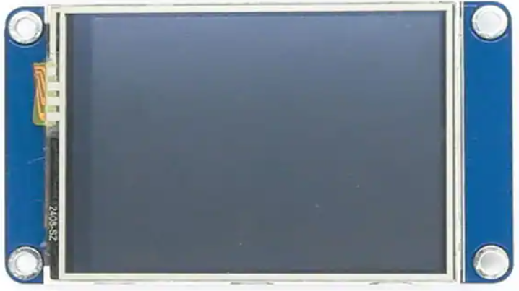
HMI Screens

Slide 2

Splash Screen
Click anywhere to exit. Return to splash screen after 60 seconds of no activity.

Slide 3
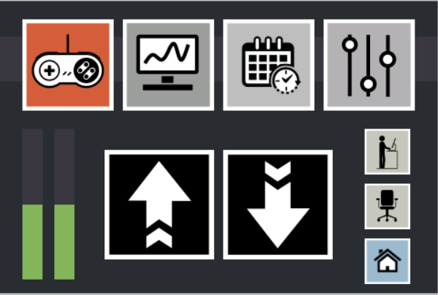
Main Control Screen
Navigation
Standing
Sitting
Calibrate
Left Leg Height
Raise Desk
Lower Desk
Right Leg Height

Slide 4
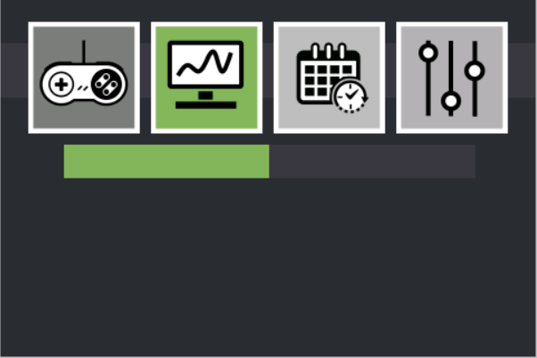
Monitor Screen
To include:
Desk level (degrees)
Leg height (inches)
Motor Speed (rpm)
1 Second Refresh rate

Slide 5
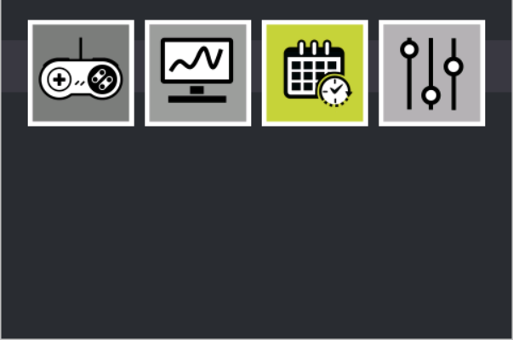
Scheduler Screen
For future development:
Set timer to change desk position
Keep track of time in standing position vs sitting position

Slide 6
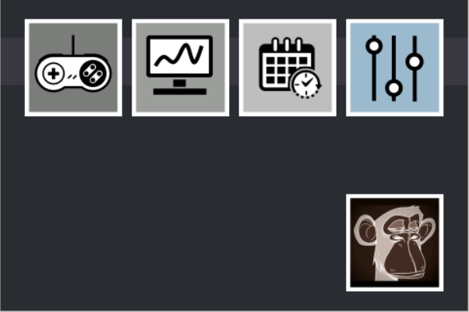
Configuration Screen
To include:
Standing position setpoint (inches)
Sitting position setpoint (inches)
Rabbit Speed (rpm)
Turtle Speed (rpm)

Slide 7
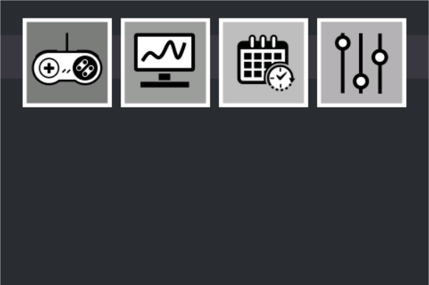
Advanced Configuration Screen
Advanced settings:
Control Gains
Single motor control

